Slide 1
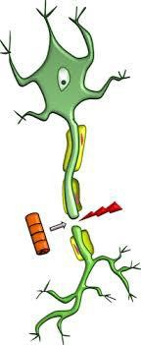
Nerve and Muscle:
Degeneration and Reinnervation
Fundamental of Neurosciences (FON) – Lecture 7
Dr Songyang Li
s.li.15@bham.ac.uk

Slide 2

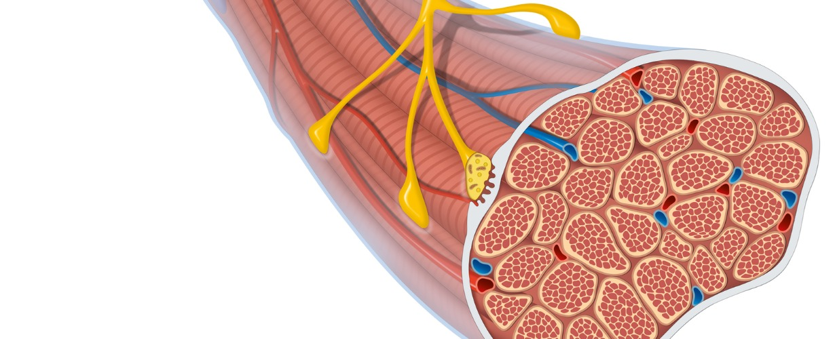
Nerve and Muscle: Degeneration and Re-innervation
One story: normal motor unit → nerve injury → degeneration → regeneration → muscle response.
Focus on lower motor neurones, peripheral nerves, skeletal muscle, and the consequences of trauma.
Keep asking: what structure is still intact, and therefore what can recover?

Slide 3
What you should be able to do by the end
Define a motor unit and identify its cellular components.
Explain how motor neurones supply skeletal muscle, smooth muscle, glands and other neurones.
Classify peripheral nerve injuries using Seddon’s system.
Describe Wallerian degeneration, chromatolysis and axonal sprouting in sequence.
Predict the fate of denervated muscle with or without re-innervation.

Slide 4
Start with what is normal before we injure it
Part 1 — Normal motor unit and motor system

Slide 5
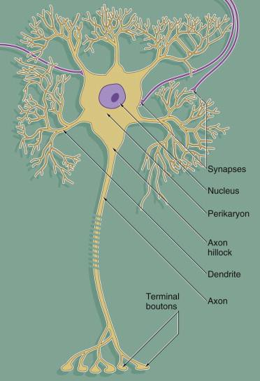
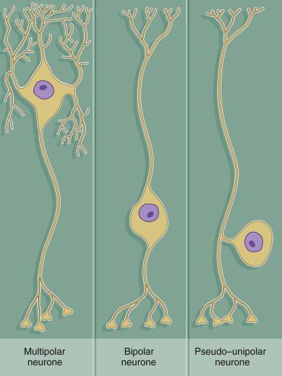
The neurone: basic structure and types
Cell body contains nucleus and protein-synthesis machinery.
Dendrites receive synaptic inputs.
Axon conducts action potentials towards terminals.
Multipolar = Motor
Bipolar = Relay or special sense Pseudo-unipolar = Sensory

Slide 6
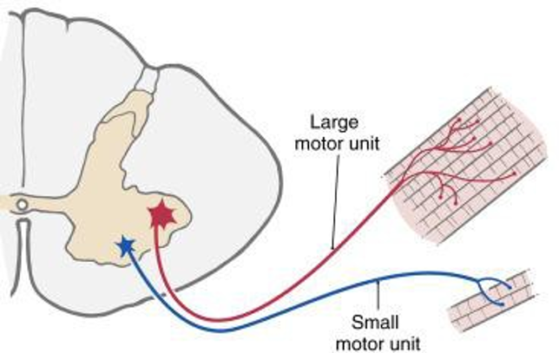
Definition: the motor unit
‘A motor unit = one motor neurone axon plus all the muscle fibres it innervates.’
Small motor units: fine control and low force.
Large motor units: powerful contraction and less precise control.
Denervation - Injury to one motor axon denervates every muscle fibre in that motor unit.

Slide 7
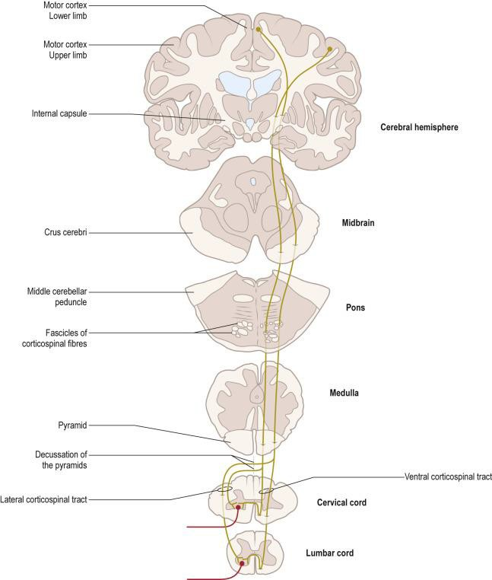
Motor units build the motor system
Descending pathways influence lower motor neurones.
The corticospinal tract (right figure) is a major pathway controlling voluntary movement.
Upper motor neurone = brain → spinal cord
lower motor neurone = spinal cord → muscle
Today we focus on lower motor neurone/peripheral axon denervation.

Slide 8
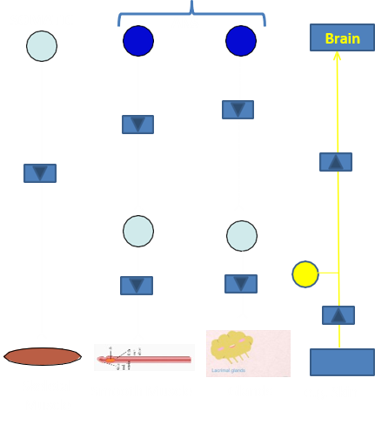
How the nervous system acts on different targets?
Motor system output can influence skeletal muscle, smooth muscle, glands and other neurones.
  Somatic motor output → skeletal muscle
  Autonomic output → smooth muscle and glands
  Sensory afferents → carry information back to the CNS

Slide 9
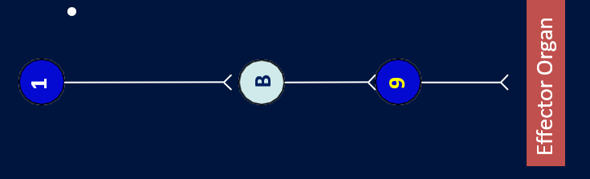
Neuronal chains and causes of degeneration
CNS
PNS
Neuronal communication often occurs through relay chains.
Causes of degeneration include
genetics
ageing
acquired injury (lacerations)
Responses of peripheral nerves to injury depends upon their locations within the neuraxis
CNS neurones generally do not regenerate effectively after injury.
Injured peripheral nerves have a capacity to regenerate and re-innervate effectors.

Slide 10
Classification is anatomy applied to trauma
Part 2 — Peripheral nerve structure and injury classification
Nerve and Muscle: Degeneration and Re-innervation
12

Slide 11
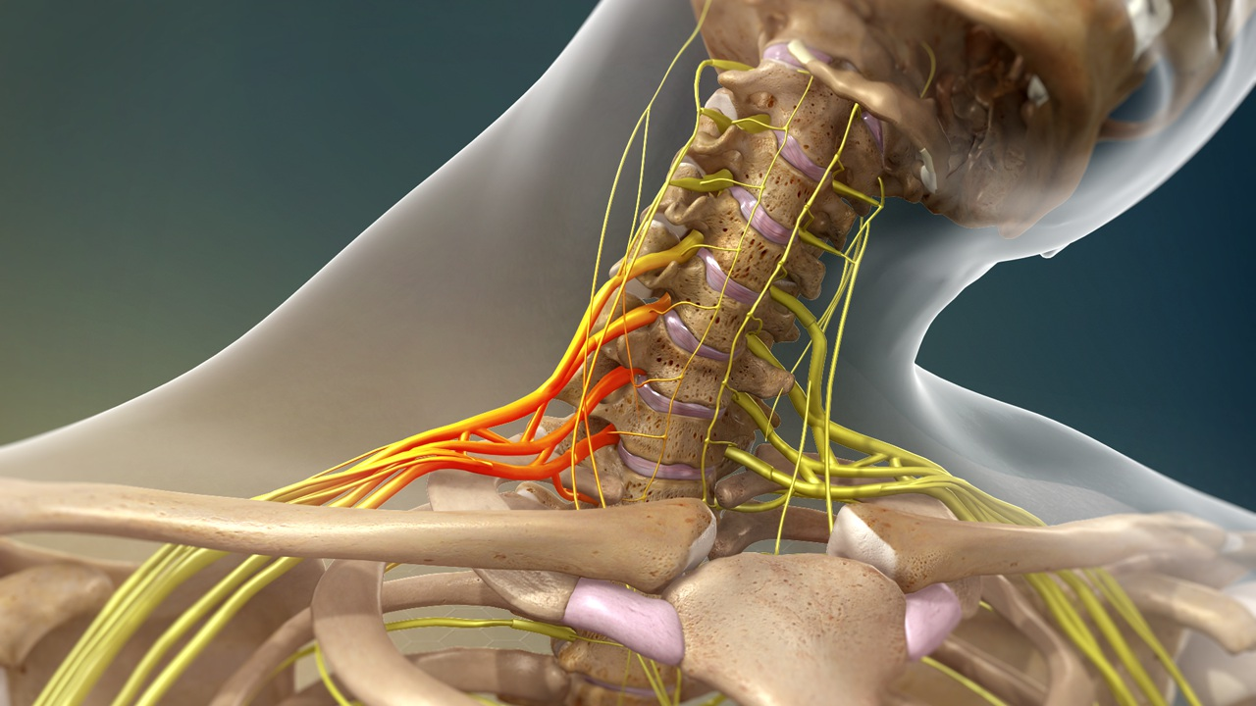
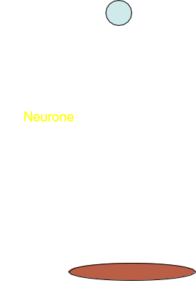
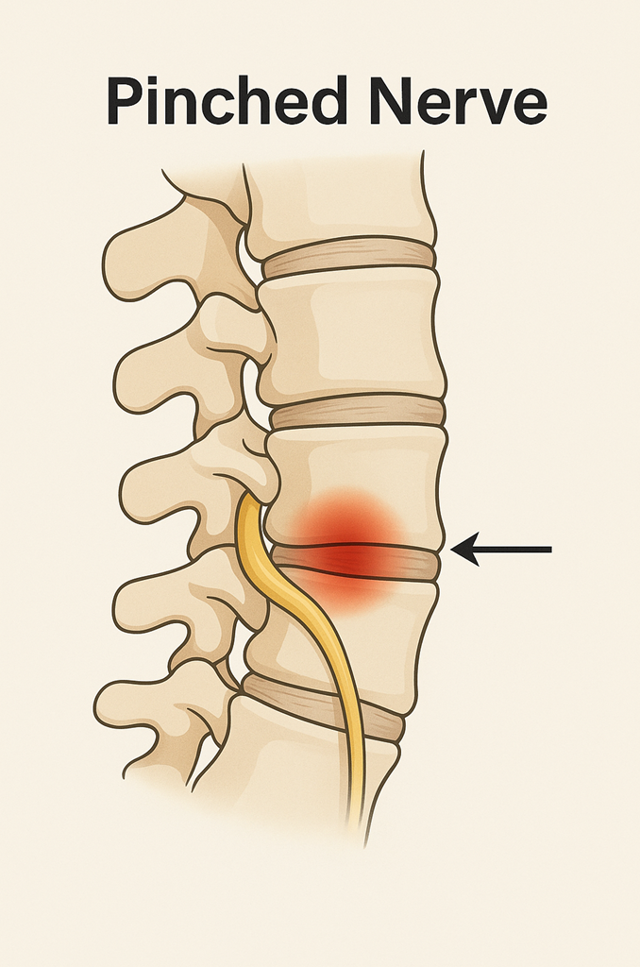
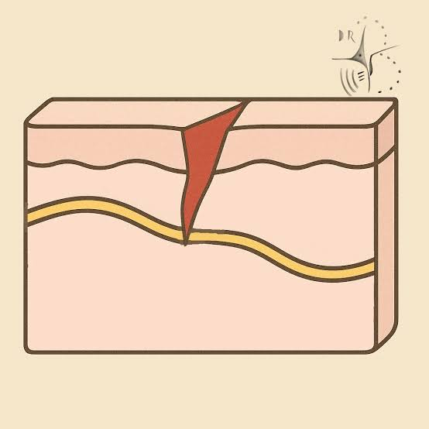
Definition of neuronal dysfunction after insult
A neurone may dysfunction if the neurone or its immediate environment is disturbed.
The extent and severity depend on the insult.
In trauma, the key question is how deep the injury reaches.
Superficial conduction problems are very different from complete transection.

Slide 12
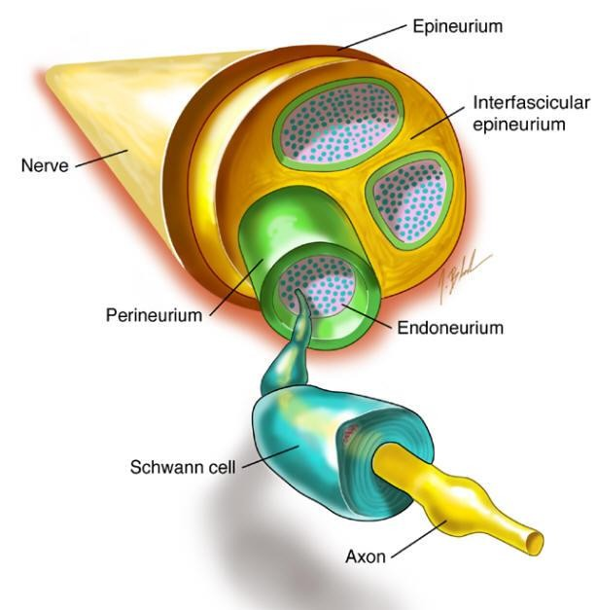
Peripheral nerve anatomy: depth matters
Epineurium (superficial)
(ensheaths the entire nerve)
  surrounds the whole nerve
Perineurium
(ensheaths a nerve fascicle)
  a fascicle is a collection of axons with common origins and destinations
Endoneurium
(ensheaths a single cell’s axon)
Myelin Sheath
Axon (deepest)

Slide 13
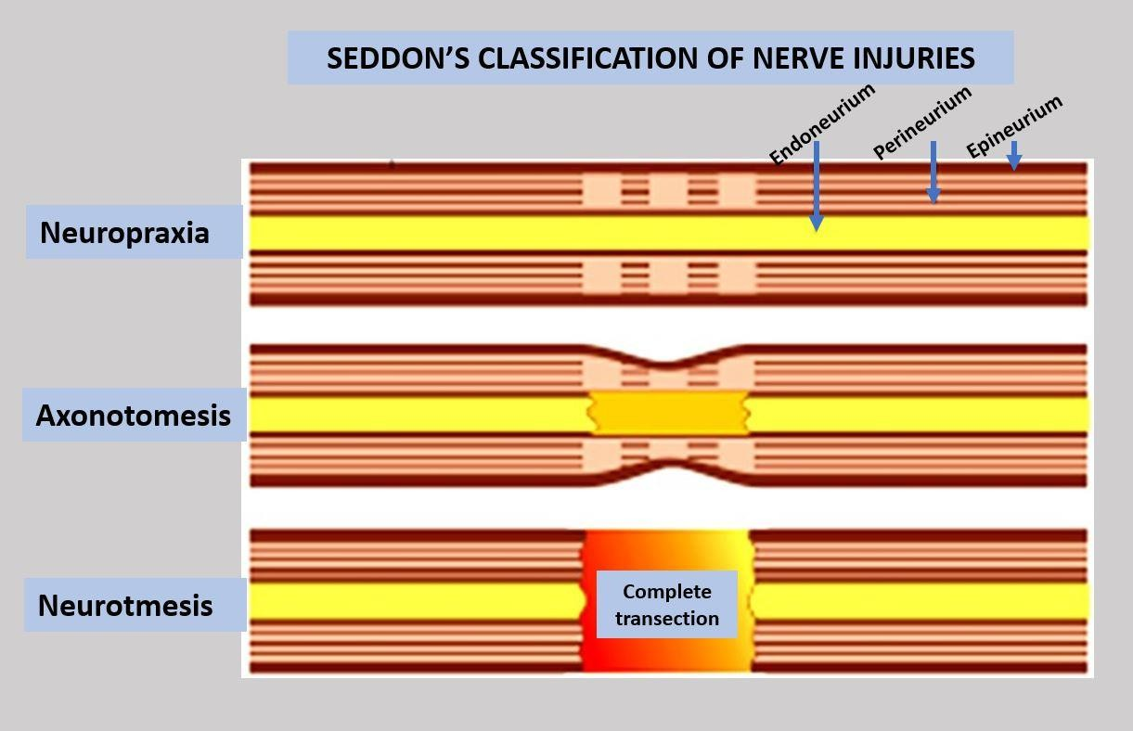
Nerve Injury overview: Seddon’s classification
Seddon’s classification based on the degree to which the insult reaches the depths of the nerve bundle
Neuropraxia: conduction block; axon remains intact.
Axonotmesis: axon and myelin damaged; connective tissue tubes may remain intact.
Neurotmesis: complete disruption of nerve continuity.
Prognosis worsens as deeper structure and guidance are lost.
Severity
of injury
Likelihood of repair
15

Slide 14
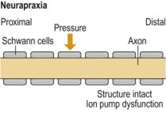
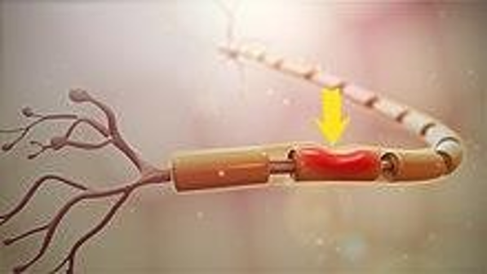
Neuropraxia: “nerve not working”
Neur-a-praxia = nerve-not-working
When a neurone temporarily loses its ability to function normally
Usually caused by pressure, traction or transient ischaemia.
The axon remains structurally continuous.
Motor function may be temporarily lost.
Recovery can be complete when conduction returns.
Key phrase: conduction block, not axonal severance.

Slide 15
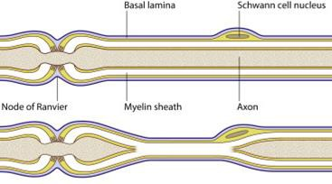
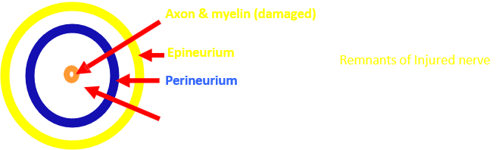
Axonotmesis: axon damaged, pathway retained
Axon and (potentially also myelin) are damaged as a result of a severe crush injury to a peripheral nerve .
The distal segment undergoes Wallerian degeneration.
Endoneurium, perineurium and epineurium may remain intact.
These preserved tubes can guide axonal sprouts.
Motor and sensory fibres can be affected in the same way.

Slide 16
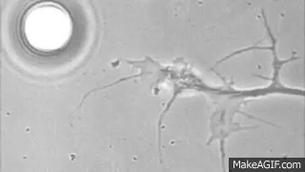

Axonotmesis: why recovery can occur
Axon and myelin remnants are damaged.
Epineurium, perineurium and endoneurium remain intact in the classic description.
New sprouts use the tubes to re-supply the target effector.
Restoration can be good if the target remains viable.

Slide 17
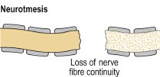
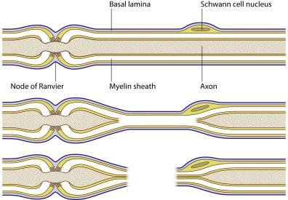
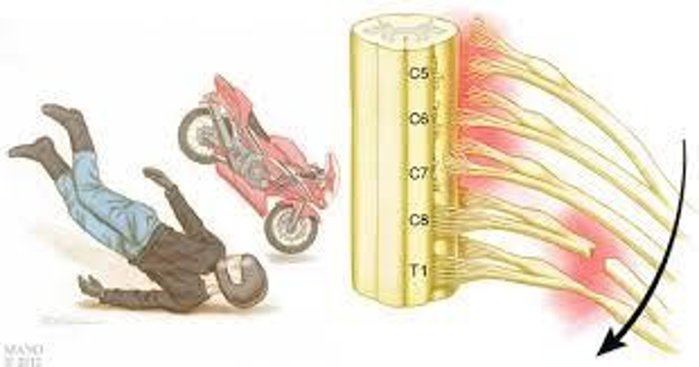
Neurotmesis: complete nerve transection
The entire nerve fibre is severed or transected.
Axon, myelin and connective tissue envelopes are divided.
Function distal to the lesion is lost.
Spontaneous recovery is poor because guidance is lost.
Surgical intervention may be needed to restore continuity.

Slide 18
After axonal injury, divide the axon into proximal and distal segments
Part 3 — What happens inside the injured neurone?
Nerve and Muscle: Degeneration and Re-innervation
24

Slide 19
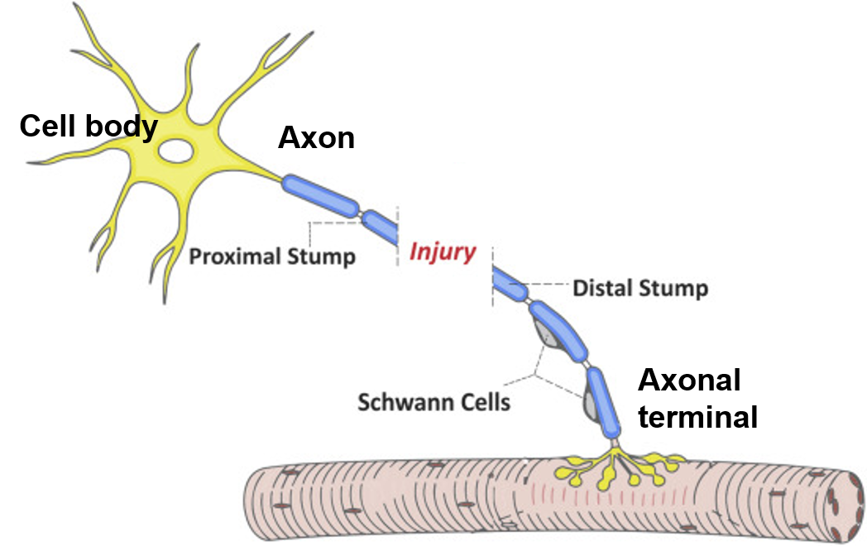
Which parts react to axonotmesis or neurotmesis?
Cell body: may survive and enter a repair programme.
Axonal terminals: degenerate early after disconnection.
Proximal stump/segment:
- survives the injury
- Likely to continue to receive support of
cell body (seals, may form neuroma, and may generate sprouts)
Distal stump/segment:
- Often cut off from cell body
- Loses potential for repairs
- Loses potential for nutritional support
- Becomes vulnerable to phagocytosis by glia
Wallerian degeneration

Slide 20
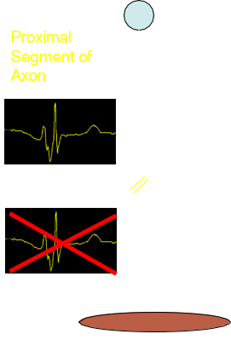
Minutes after injury: conduction stops
The first consequence is functional disconnection beyond the lesion.
Minutes After Injury is Sustained
Action potentials cannot pass the injury site.
The target effector is no longer receiving normal neural input.
Cut ends leak intracellular fluid, then pull apart, seal and swell.
Axonal transport in both directions is interrupted.

Slide 21
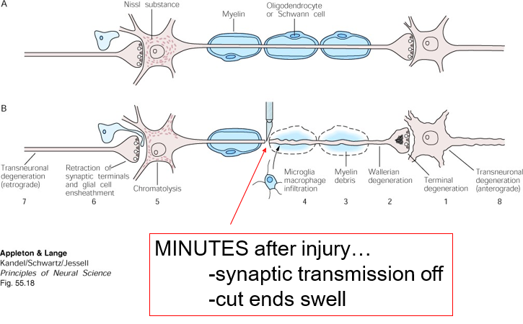
The classic injury sequence diagram

Slide 22
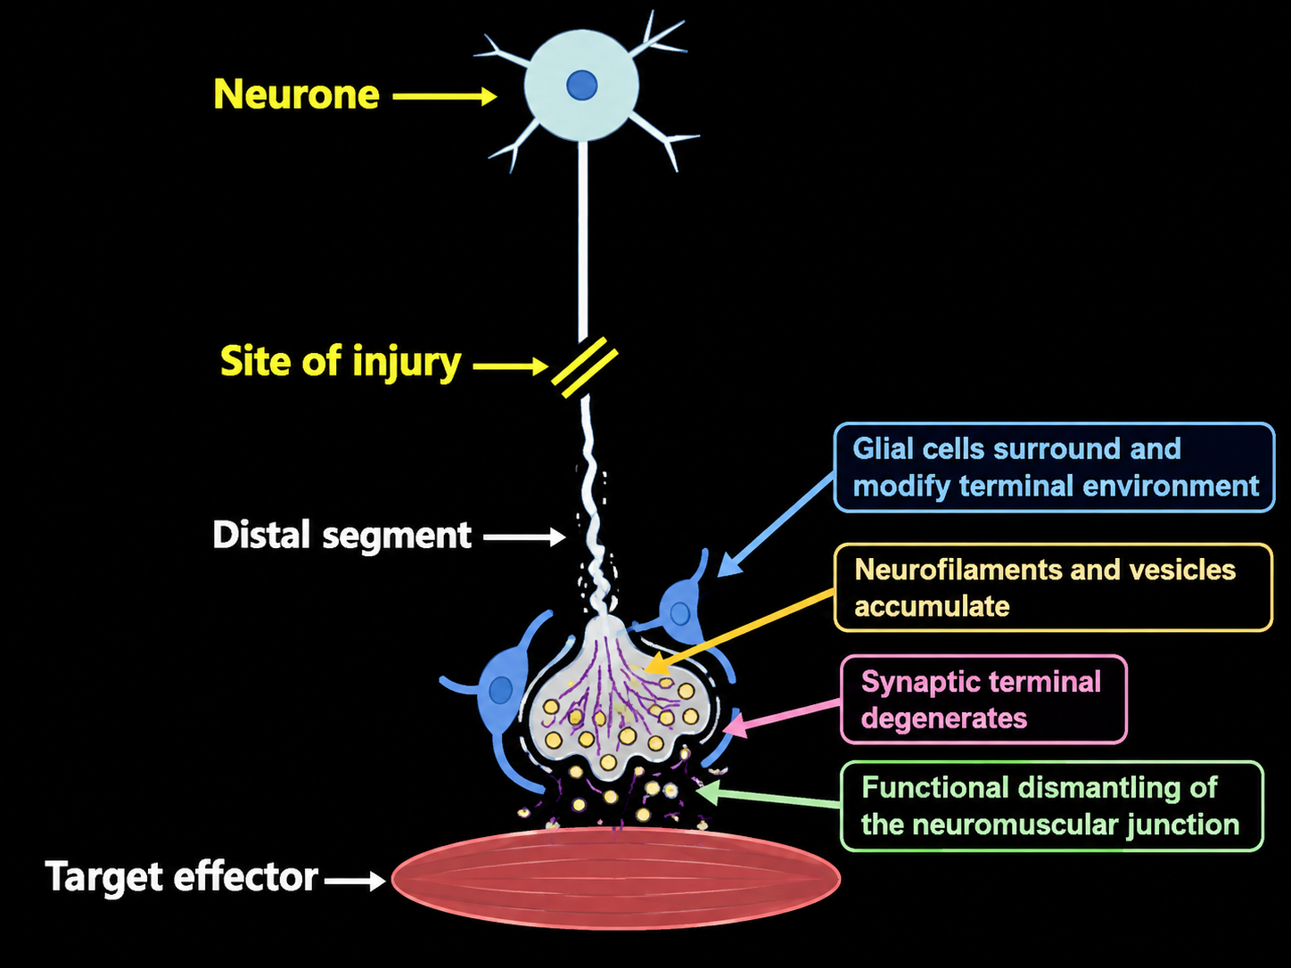
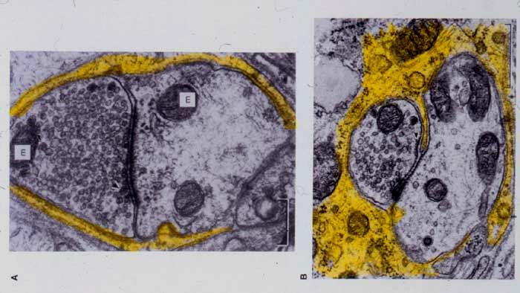
Hours after injury: terminal degeneration begins
An Hour or So After Injury is Sustained
Synaptic terminal degenerates.
Neurofilaments and vesicles accumulate in the damaged terminal.
Glial cells can surround and modify the terminal environment.
In a motor unit, the neuromuscular junction is being dismantled functionally.
INJURIED
ASTROGLIA SURROUND SYNAPTIC TERMINAL
NORMAL

Slide 23
The distal segment is cut off from the cell body and cannot maintain itself
Part 4 — Distal segment: Wallerian degeneration
Nerve and Muscle: Degeneration and Re-innervation
32

Slide 24
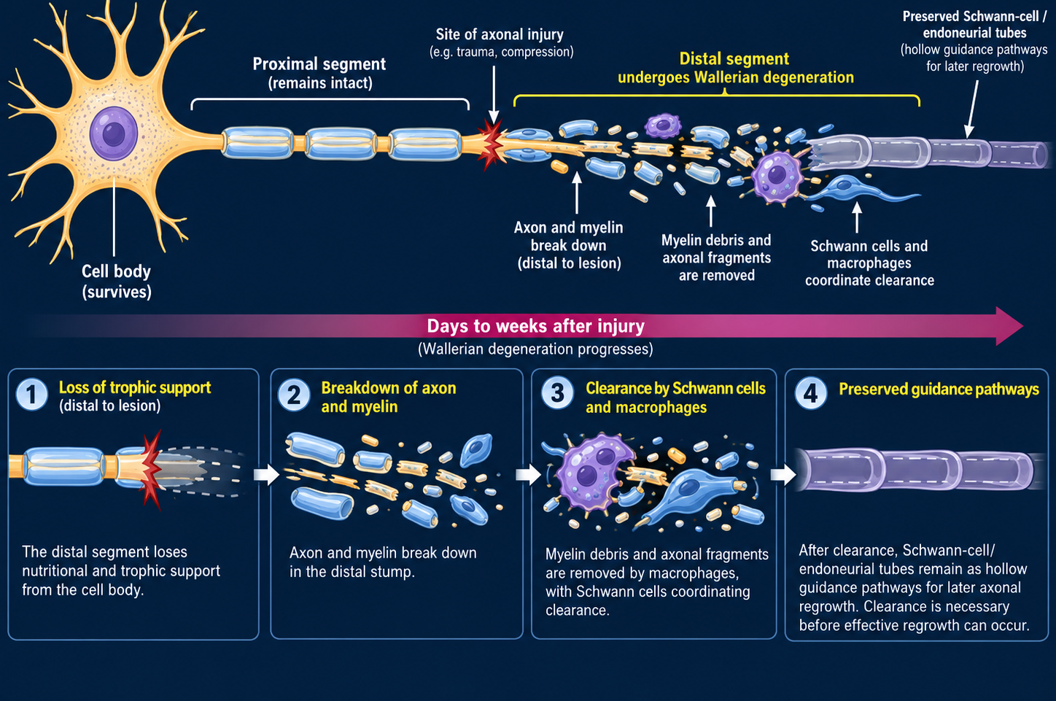
Fate of the distal segment
Days to weeks: Wallerian degeneration progresses

Slide 25
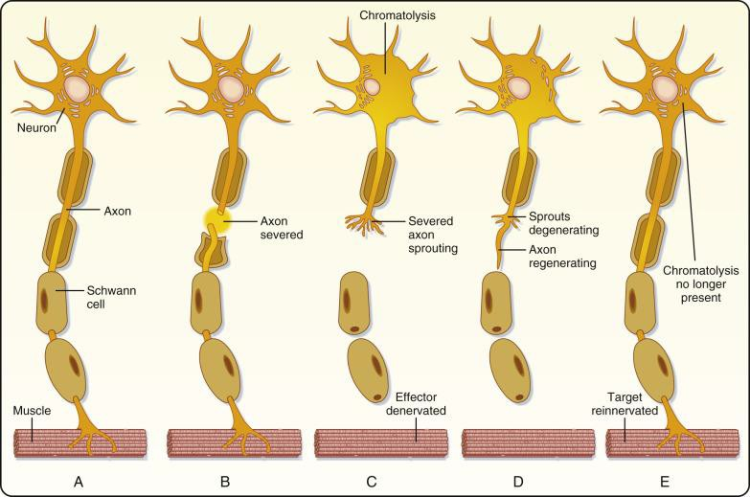
Guidance structures after distal degeneration
Endoneurial tubes and basal lamina can remain as a scaffold.
Schwann cells align along the former axonal pathway.
New axonal sprouts need to enter the correct tube.
Misdirection or failure produces incomplete recovery.

Slide 26
The proximal neurone survives only if the cell body remains viable
Part 5 — Proximal segment: chromatolysis and sprouting
Nerve and Muscle: Degeneration and Re-innervation
36

Slide 27
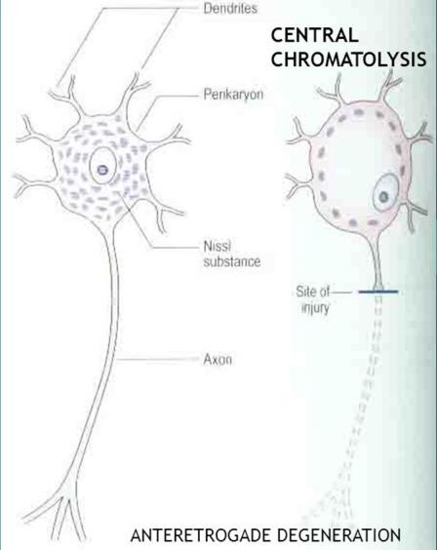
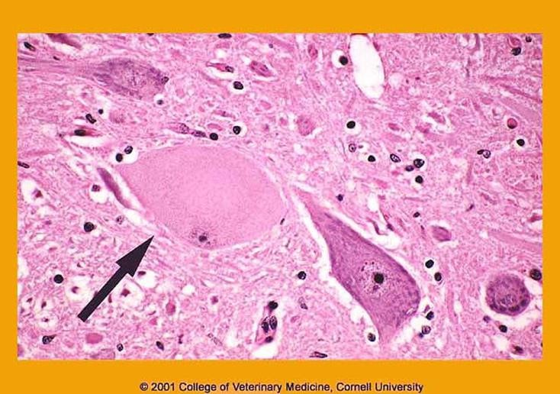
Fate of the proximal segment: chromatolysis
Chromatolysis occurs days after injury.
Chromatolysis is the dissolution, dispersion, or fragmentation of Nissl bodies in the cell body (soma) of a neuron in response to injury or stress.
Cell body becomes active and synthesises repair proteins.
Soma swells and Nissl substance disperses.
Nucleus is displaced towards the periphery.
The wounded stump seals and may form a neuroma.

Slide 28
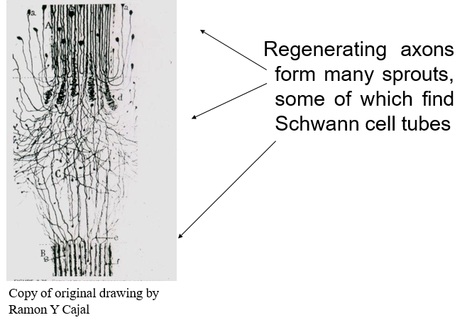
Proximal stump: axonal sprouts search for tubes
Many sprouts form; only some find useful guidance pathways.
Regenerating axons form many sprouts.
Some sprouts find Schwann-cell tubes.
Unsuccessful sprouts may degenerate or form neuroma.
Successful sprouts may reach and re-innervate the target.

Slide 29
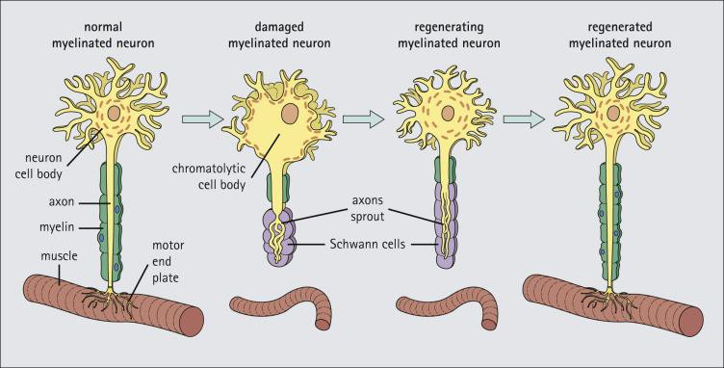
Repair in the PNS: from damage to re-innervation

Slide 30
The effector changes while waiting for nerve supply to return
Part 6 — What happens to denervated skeletal muscle?
Nerve and Muscle: Degeneration and Re-innervation
42

Slide 31
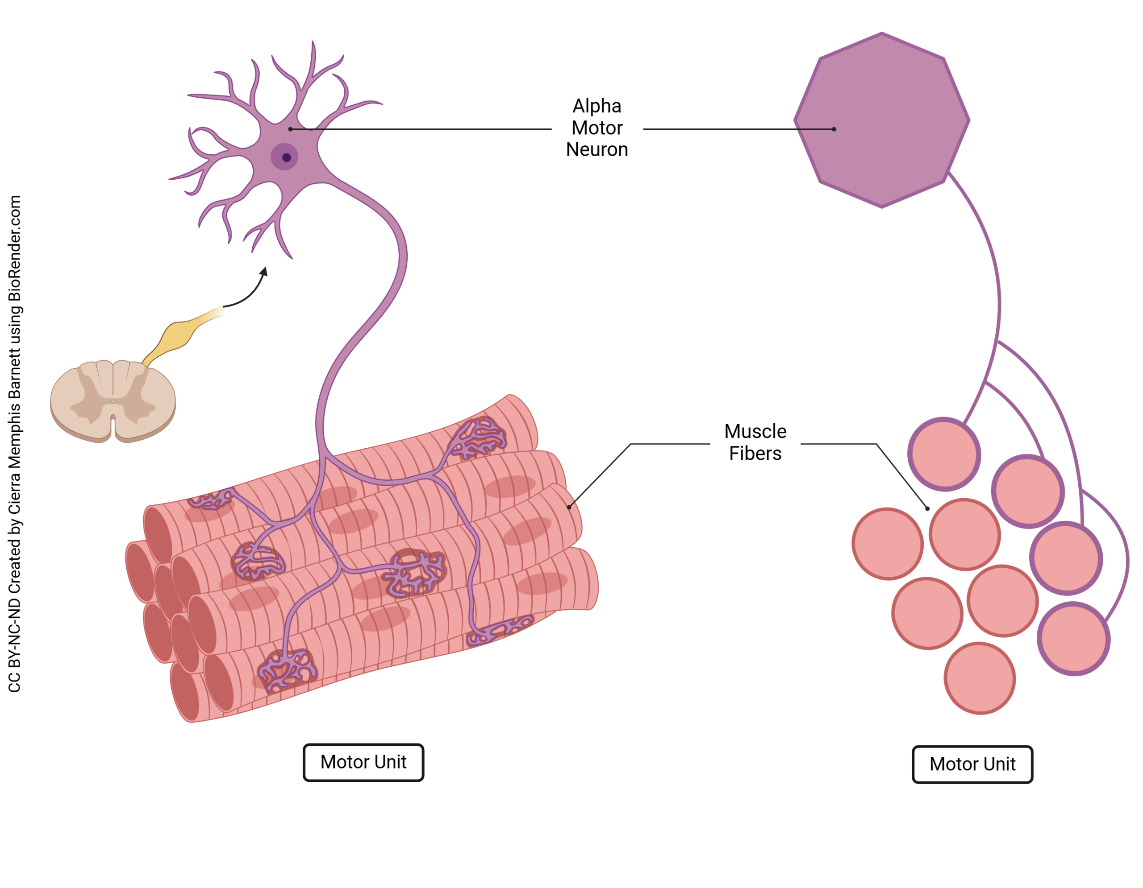
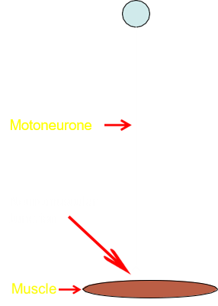
Innervation, denervation and re-innervation
Innervation: normal nerve supply to a muscle or other target.
Alpha α- /lower motor neurones innervate skeletal muscle.
Denervation: loss of nerve supply.
Depriving The Muscle of Its Nerve Supply
Re-innervation: regrowth/restoration of nerve supply to the target.

Slide 32
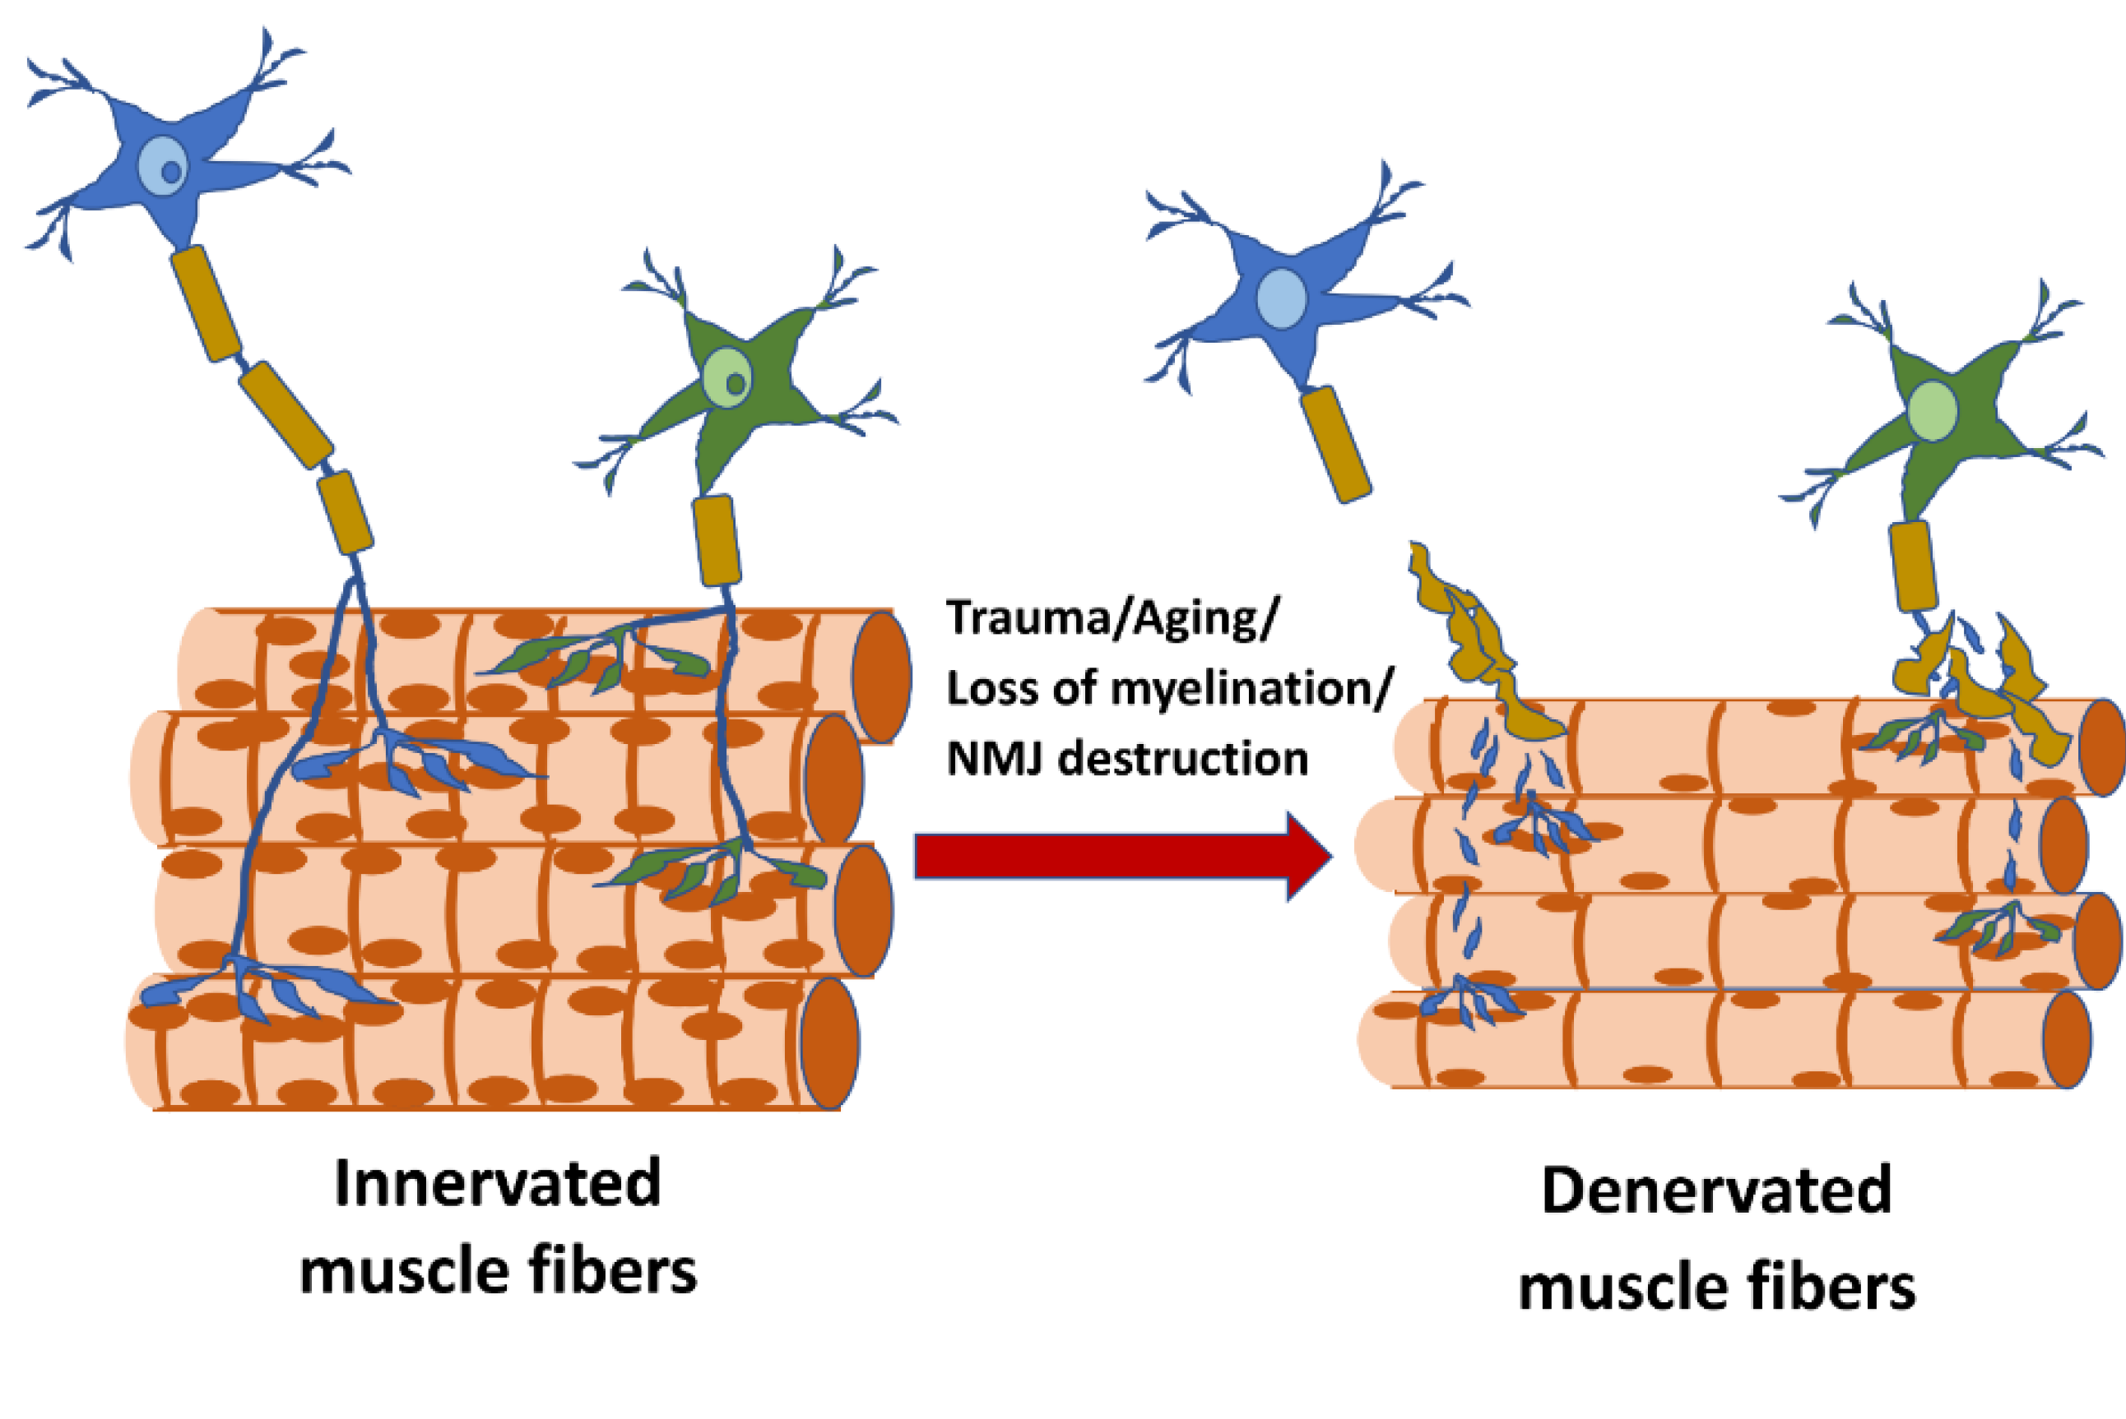
Denervation of motor supply to skeletal muscle
The neuromuscular junction no longer receives normal motor command.
Voluntary contraction is lost or markedly reduced.
Reflex arcs involving the motor unit fail.
Muscle tone falls because lower motor output is absent.
Denervation atrophy develops if supply is not restored.
Nerve and Muscle: Degeneration and Re-innervation
44

Slide 33
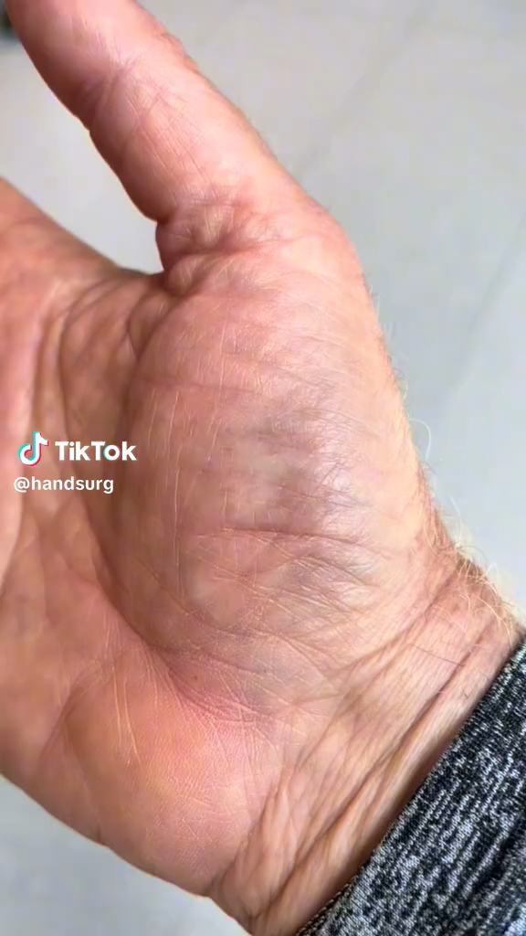
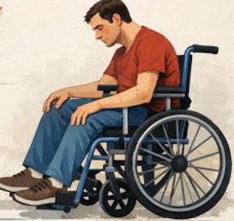
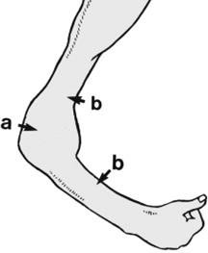
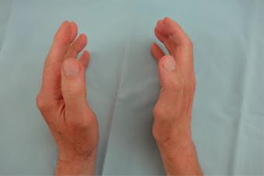
The Fate of A Denervated Muscle That is Not Reinnervated
Acute denervation
Chronic denervation
Immediate paralysis, usually flaccid.
Areflexia: reflexes requiring that motor unit are lost or reduced.
Atonia: loss of normal muscle tone.
Fasciculations may appear as spontaneous motor-unit activity.
If re-innervation fails, fasciculations may later subside.
Muscle loses bulk due to denervation atrophy.
Do not confuse denervation atrophy with disuse atrophy.
Muscle fibres may die over time.
Connective tissue and fat replace muscle tissue.
Fibrosis makes late functional recovery difficult.

Slide 34
Regrowth can restore function, but it may not recreate the original wiring
Part 7 — Re-innervation: recovery, reorganisation and misdirection
Nerve and Muscle: Degeneration and Re-innervation
49

Slide 35
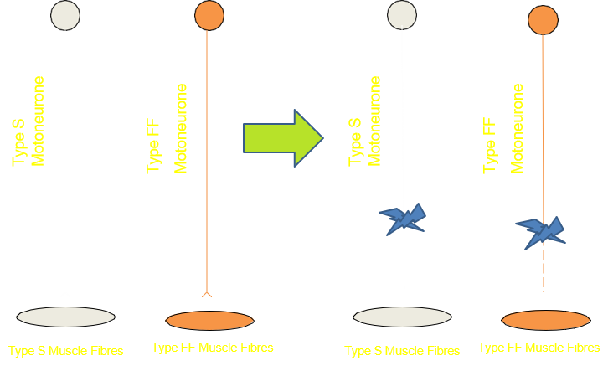
Experimental re-innervation by a different motor type

Slide 36
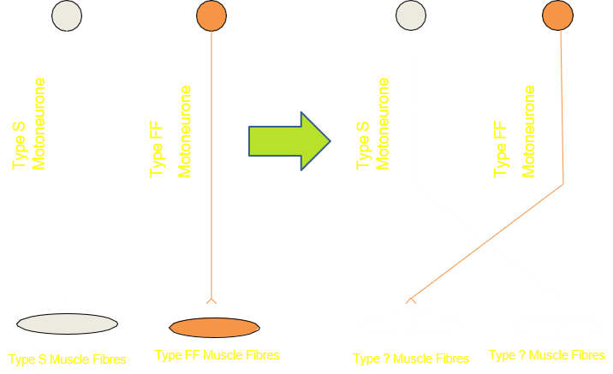
Predict: what happens when nerve supplies are switched?
A, fibre type does not change because muscle fibres are genetically fixed.
B, fibre type changes partly because both muscle and nerve influence the phenotype.
C, fibre type switches to match the characteristics of the supplying motor nerve.

Slide 37
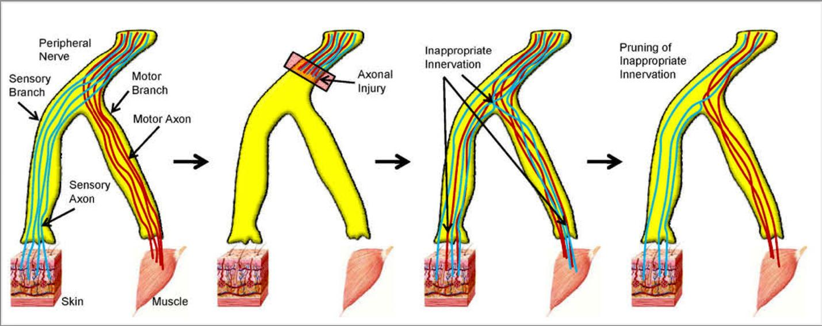
Re-innervation of the original target may fail
Axons aim to re-supply the original effector organ.
The original target may not be reached successfully.
A regenerated axon may supply a different effector.
This can produce unexpected clinical syndromes.
Correct targeting depends on preserved pathways and alignment.

Slide 38
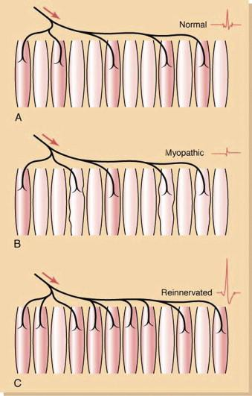
Motor unit potentials after re-innervation
A normal motor unit has a characteristic motor unit potential.
Denervation reduces effective motor unit activity.
Re-innervation can produce larger or altered potentials.
Surviving axons may innervate fibres previously supplied by other motor neurones.
Recovered motor units may be functional but not identical to the original.

Slide 39
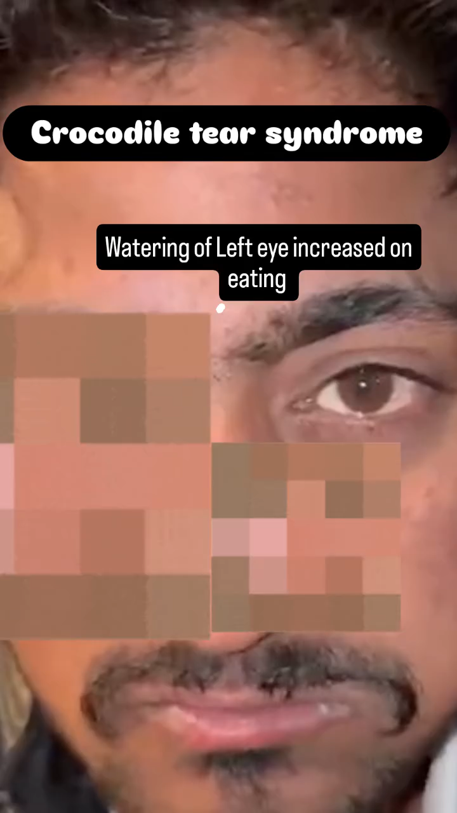

Inappropriate re-innervation: crocodile tears syndrome
Also known as Bogorad’s phenomenon or gustatory hyperlacrimation.
Eating can trigger lacrimation when autonomic fibres are misdirected.
wrong target and misdirected regeneration.

Slide 40
Not every muscle responds to denervation in the same way, and trauma can injure muscle directly
Part 8 — Effector type and trauma-related muscle damage
Nerve and Muscle: Degeneration and Re-innervation
56

Slide 41
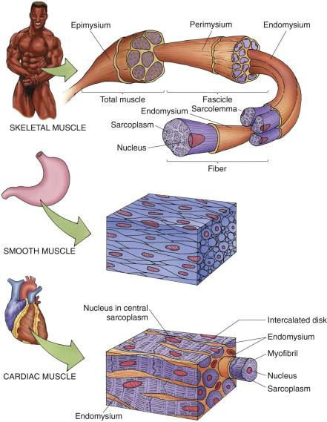
Does the type of muscle matter?
Skeletal, smooth and cardiac muscle differ in neural dependence.
Skeletal muscle contraction depends directly on somatic motor neurone activation.
Smooth and cardiac muscle are myogenic.
Autonomic nerves modulate smooth and cardiac muscle activity.
Therefore, denervation consequences differ by effector type.
Nerve and Muscle: Degeneration and Re-innervation
57

Slide 42
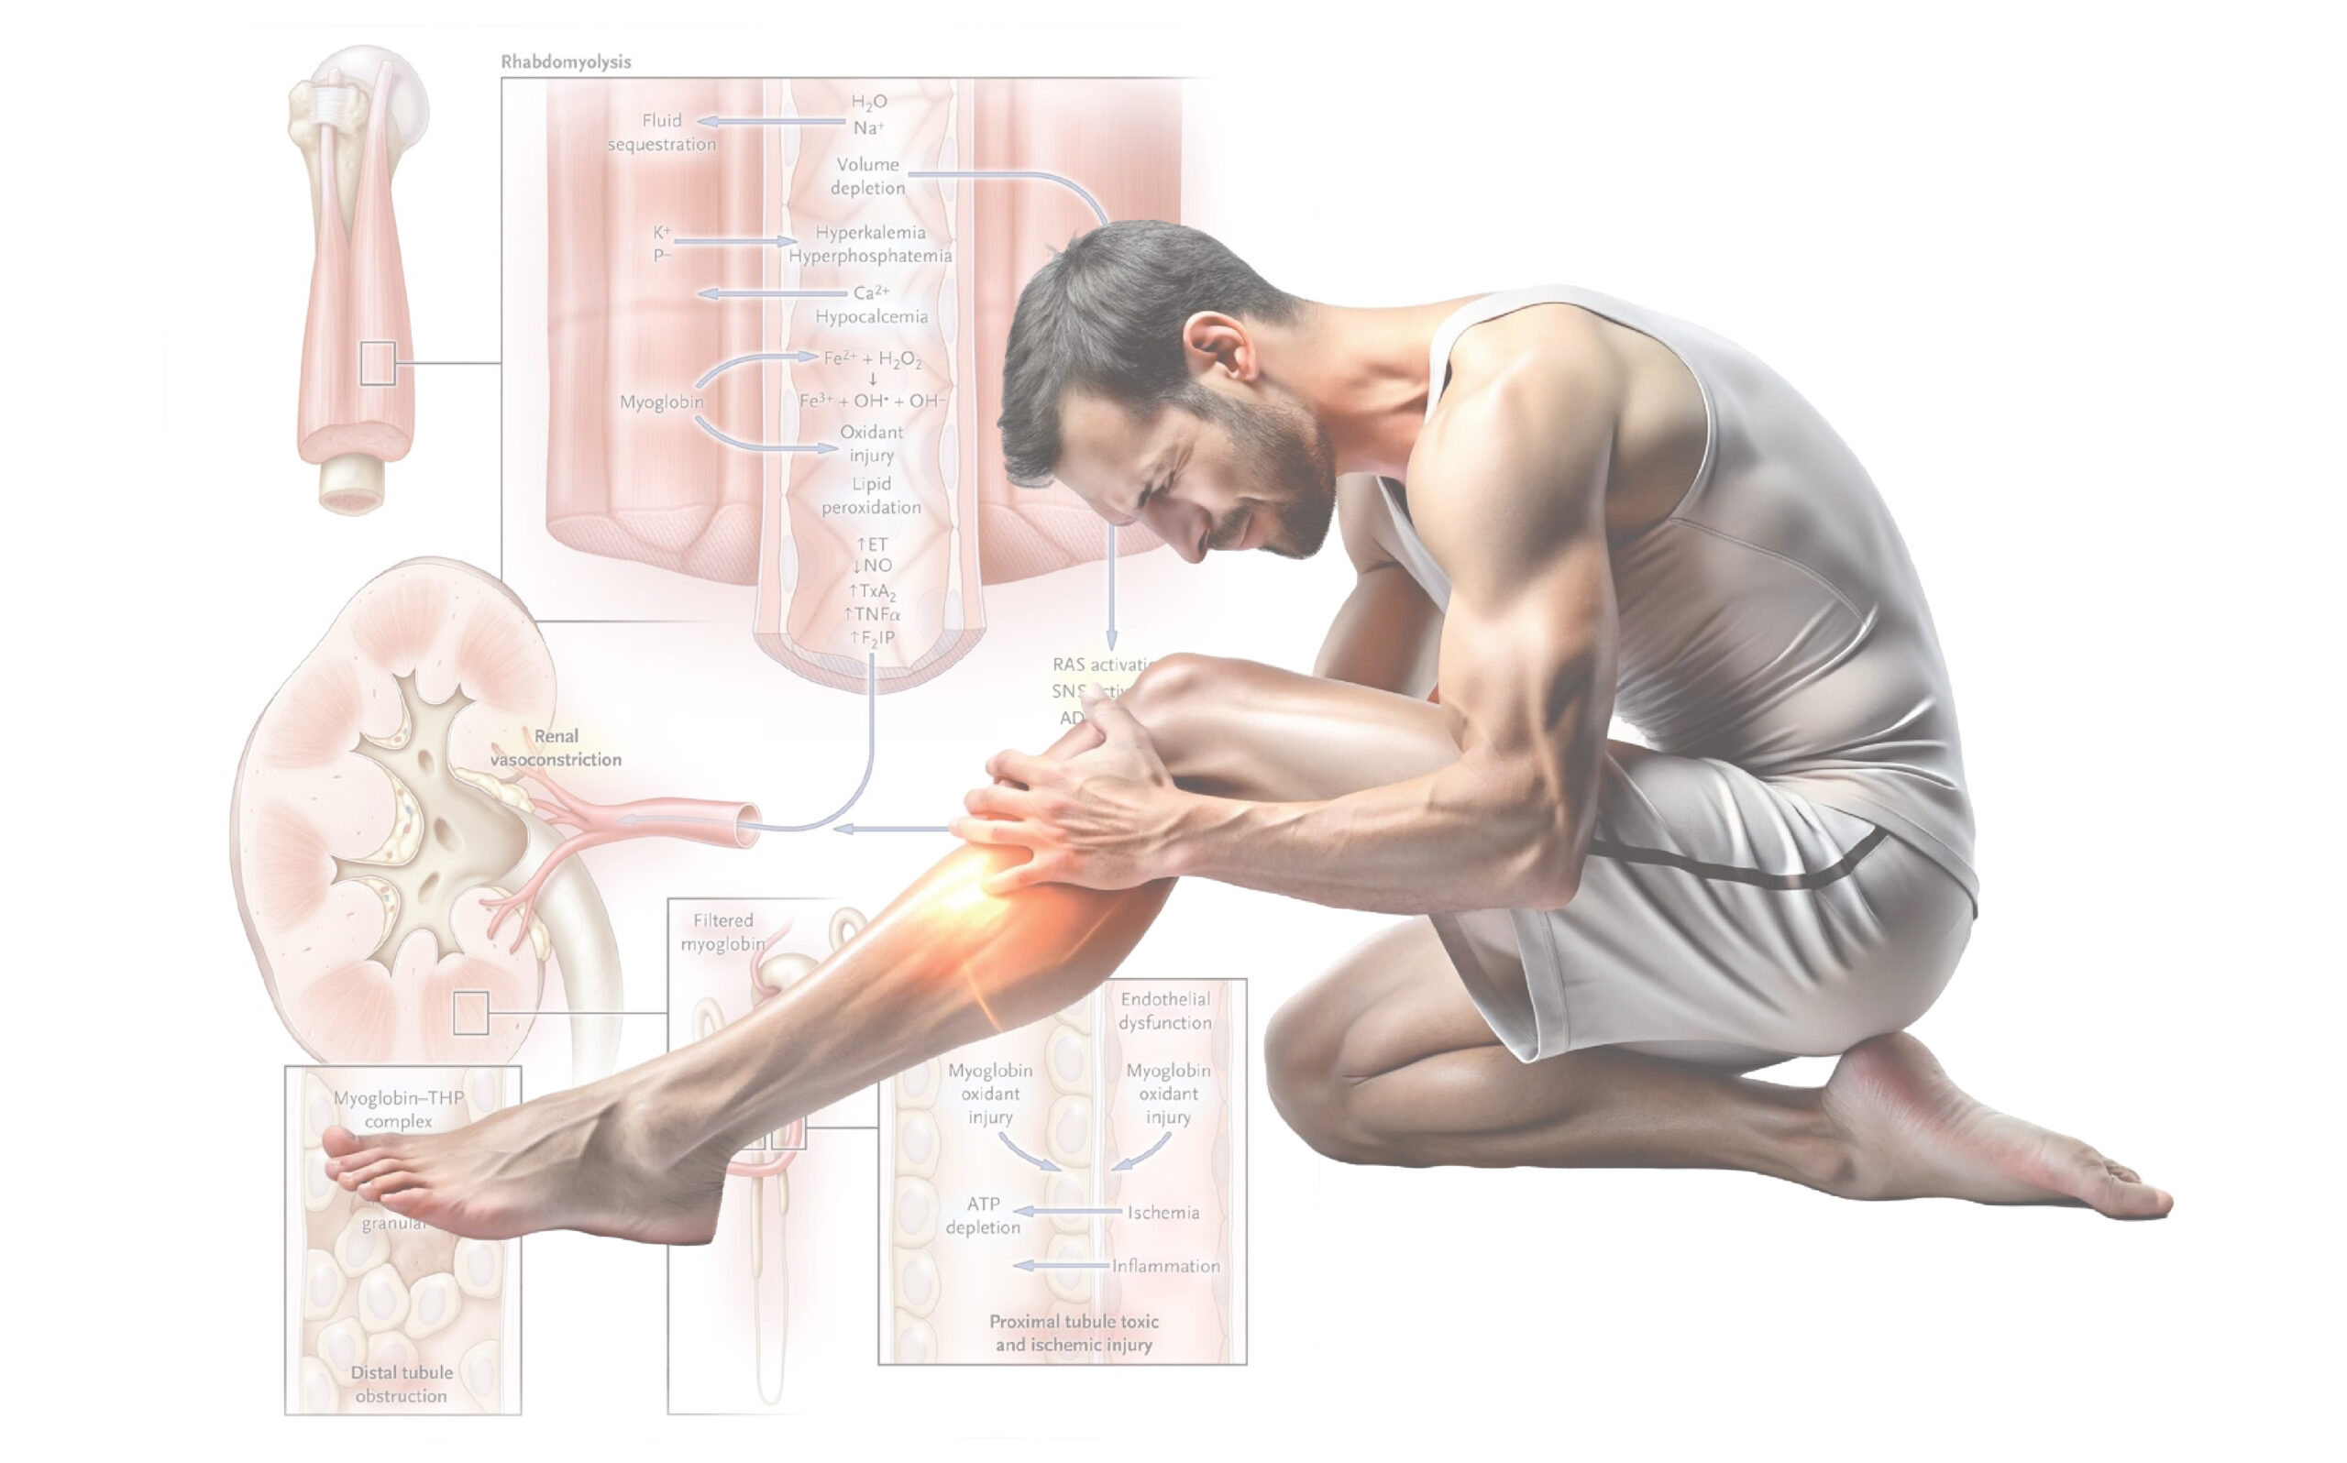
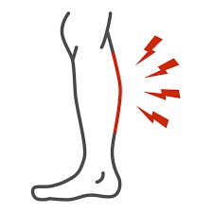
Rhabdomyolysis: direct muscle destruction after trauma
Rhabdomyolysis is breakdown of skeletal muscle with release of intracellular contents into circulation.
It can cause acute renal failure and may be life-threatening.
Causes include crush syndrome, high-speed accidents, injected substances, extreme exercise and muscle pathology.
Mechanism differs from gradual denervation atrophy.

Slide 43
Now rebuild the whole lecture from first principles
Part 9 — Integrated timeline and exam practice
Nerve and Muscle: Degeneration and Re-innervation
59

Slide 44
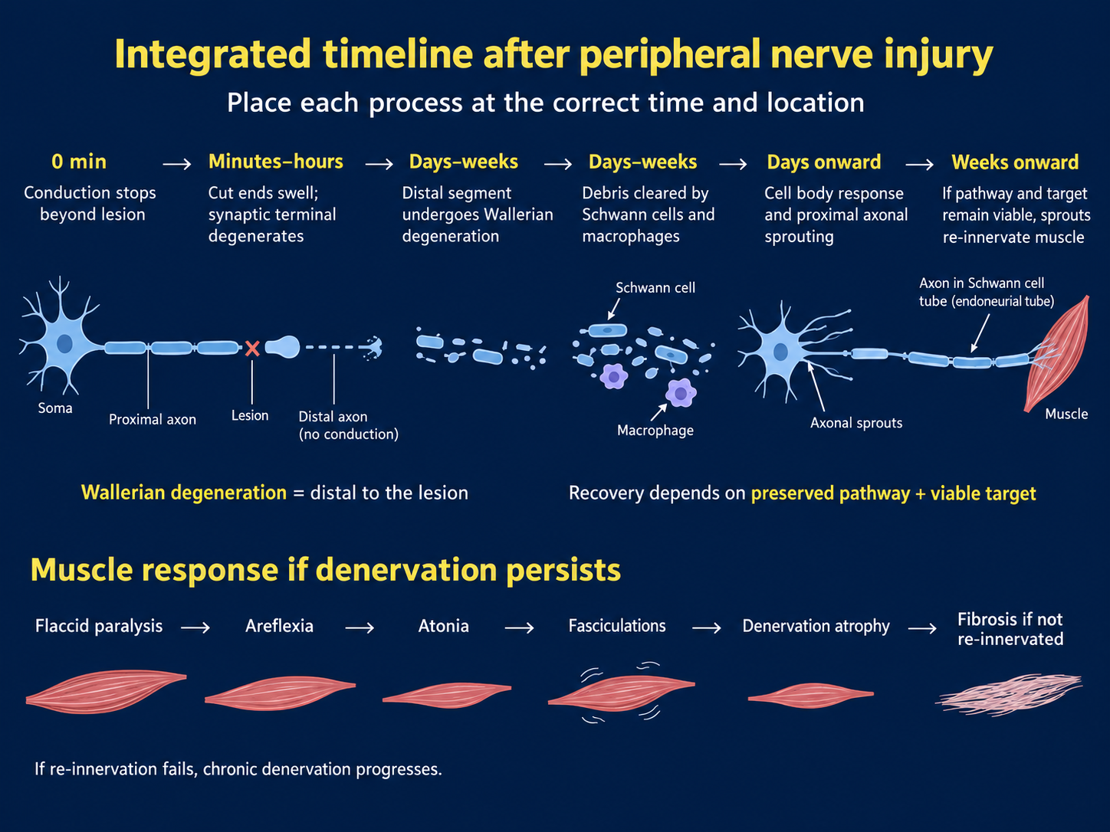

Slide 45
Check your understanding
Why does neuropraxia usually recover better than axonotmesis?
Why does axonotmesis recover better than neurotmesis?
Which segment undergoes Wallerian degeneration?
Nerve and Muscle: Degeneration and Re-innervation
61

Slide 46
Summary: seven take-home messages
A motor unit is one motor axon plus the muscle fibres it innervates.
Peripheral nerve injury outcome depends on structural preservation.
Seddon: neuropraxia, axonotmesis, neurotmesis.
Distal axon: Wallerian degeneration; proximal soma: chromatolysis.
Schwann cells, macrophages and preserved tubes support regrowth.
Denervated skeletal muscle becomes paralysed, loses tone, may fasciculate, wastes and can become fibrotic.
Re-innervation can restore function, but may be incomplete or inappropriate.

Slide 47

Questions
Thank you
If you have any questions
Please email me Dr. Songyang Li
s.li.15@bham.ac.uk

Slide 48
Model answers: say it in exam language
1. Why does neuropraxia usually recover better than axonotmesis?
Neuropraxia usually recovers better because the axon remains structurally intact and the problem is mainly a temporary conduction block. There is no distal axonal degeneration, so recovery can occur once normal conduction is restored. In axonotmesis, the axon is disrupted and the distal segment undergoes Wallerian degeneration, so recovery depends on successful axonal regrowth.
2. Why does axonotmesis recover better than neurotmesis?
In axonotmesis, although the axon is damaged, the surrounding connective tissue and Schwann-cell pathways may remain intact. These structures can guide regenerating axonal sprouts back towards the original target. In neurotmesis, the nerve and its guiding structures are severely disrupted, so spontaneous regeneration is much less successful and surgical repair may be required.
3. Which segment undergoes Wallerian degeneration?
The distal segment, meaning the part of the axon distal to the site of injury, undergoes Wallerian degeneration. This occurs because the distal segment has been disconnected from the neuronal cell body and loses metabolic and trophic support.

